Slide 1
SLEEP DISORDER PREDICTION BASED ON LIFESTYLE
PRESENTED
BY
MOHAMMED SUHAIL M R
02/12/2024

Slide 2
WHAT IS SLEEP DISORDER :
SLEEP DISORDERS ARE CONDITIONS THAT RESULT IN CHANGES IN THE WAY THAT YOU SLEEP. THEY INVOLVE PROBLEMS WITH THE QUALITY, TIMING, AND AMOUNT OF SLEEP, WHICH RESULT IN DAYTIME DISTRESS AND IMPAIRMENT IN FUNCTIONING. SLEEP DEPRIVATION CAN AFFECT YOUR ABILITY TO DRIVE SAFELY AND INCREASE YOUR RISK OF OTHER HEALTH PROBLEMS.
YOU HAVE TROUBLE FALLING OR REMAINING ASLEEP
YOU FIND IT DIFFICULT TO STAY AWAKE DURING THE DAY
THERE ARE IMBALANCES IN YOUR CIRCADIAN RHYTHM THAT INTERFERE WITH A HEALTHY SLEEP SCHEDULE
YOU ARE PRONE TO UNUSUAL BEHAVIORS THAT DISRUPT YOUR SLEEP

Slide 3
AIM OF THE PROJECT :
THE AIM OF THE PROJECT IS TO ANALYZE THE PERSON'S LIFESTYLES AND MEDICAL VARIABLES SUCH AS,
AGE, BMI(BODY MASS INDEX), PHYSICAL ACTIVITY, SLEEP DURATION, BLOOD PRESSURE AND MANY MORE.
TO PREDICT THE SLEEP DISORDER AND ITS TYPE.

Slide 4
DATA SET :
Person ID | Gender | Age | Occupation | Sleep Duration | Quality of Sleep | Physical Activity Level | Stress Level | BMI Category | Blood Pressure | Heart Rate | Daily Steps | Sleep Disorder
1 | Male | 27 | Software Engineer | 6.1 | 6 | 42 | 6 | Overweight | 126/83 | 77 | 4200 | None
2 | Male | 28 | Doctor | 6.2 | 6 | 60 | 8 | Normal | 125/80 | 75 | 10000 | None
3 | Male | 28 | Doctor | 6.2 | 6 | 60 | 8 | Normal | 125/80 | 75 | 10000 | None
4 | Male | 28 | Sales Representative | 5.9 | 4 | 30 | 8 | Obese | 140/90 | 85 | 3000 | Sleep Apnea
5 | Male | 28 | Sales Representative | 5.9 | 4 | 30 | 8 | Obese | 140/90 | 85 | 3000 | Sleep Apnea
6 | Male | 28 | Software Engineer | 5.9 | 4 | 30 | 8 | Obese | 140/90 | 85 | 3000 | Insomnia
7 | Male | 29 | Teacher | 6.3 | 6 | 40 | 7 | Obese | 140/90 | 82 | 3500 | Insomnia
8 | Male | 29 | Doctor | 7.8 | 7 | 75 | 6 | Normal | 120/80 | 70 | 8000 | None
9 | Male | 29 | Doctor | 7.8 | 7 | 75 | 6 | Normal | 120/80 | 70 | 8000 | None
10 | Male | 29 | Doctor | 7.8 | 7 | 75 | 6 | Normal | 120/80 | 70 | 8000 | None
11 | Male | 29 | Doctor | 6.1 | 6 | 30 | 8 | Normal | 120/80 | 70 | 8000 | None
12 | Male | 29 | Doctor | 7.8 | 7 | 75 | 6 | Normal | 120/80 | 70 | 8000 | None
13 | Male | 29 | Doctor | 6.1 | 6 | 30 | 8 | Normal | 120/80 | 70 | 8000 | None
14 | Male | 29 | Doctor | 6 | 6 | 30 | 8 | Normal | 120/80 | 70 | 8000 | None
15 | Male | 29 | Doctor | 6 | 6 | 30 | 8 | Normal | 120/80 | 70 | 8000 | None
16 | Male | 29 | Doctor | 6 | 6 | 30 | 8 | Normal | 120/80 | 70 | 8000 | None
18 | Male | 29 | Doctor | 6 | 6 | 30 | 8 | Normal | 120/80 | 70 | 8000 | Sleep Apnea

Slide 5
ABOUT THE DATASET :
THE SLEEP HEALTH AND LIFESTYLE DATASET COMPRISES 400 ROWS AND 13 COLUMNS, COVERING A WIDE RANGE OF VARIABLES RELATED TO SLEEP AND DAILY HABITS. IT INCLUDES DETAILS SUCH AS GENDER, AGE, OCCUPATION, SLEEP DURATION, QUALITY OF SLEEP, PHYSICAL ACTIVITY LEVEL, STRESS LEVELS, BMI CATEGORY, BLOOD PRESSURE, HEART RATE, DAILY STEPS, AND THE PRESENCE OR ABSENCE OF SLEEP DISORDERS.

Slide 6
KEY FEATURES OF THE DATASET :
Comprehensive Sleep Metrics: Explore sleep duration, quality, and factors influencing sleep patterns.
Lifestyle Factors: Analyze physical activity levels, stress levels, and BMI categories.
Cardiovascular Health: Examine blood pressure and heart rate measurements Sleep.
Disorder Analysis: Identify the occurrence of sleep disorders such as Insomnia and Sleep Apnea.

Slide 7
WORK FLOW :
DATA IMPORT AND INITIAL CHECK
DATA CLEANING
OUTLIER DETECTION AND HANDLING
EXPLORATORY DATA ANALYSIS ( EDA )

Slide 8
DATA DICTIONARY
Column Name | Description
PERSON ID | Unique ID assigned to each person
GENDER | The gender of the person (Male/Female)
AGE | Age of the person in years
OCCUPATION | The occupation of the person
SLEEP DURATION | The duration of sleep of the person in hours
QUALITY OF SLEEP | A subjective rating of the quality of sleep, ranging from 1 to 10
PHYSICAL ACTIVITY | The level of physical activity of the person (Low/Medium/High)
STRESS LEVEL | A subjective rating of the stress level, ranging from 1 to 10
BMI CATEGORY | The BMI category of the person(Underweight/Normal/Overweight/Obesity)
BLOOD PRESSURE | The blood pressure of the person in mmHg
HEART RATE | The heart rate of the person in beats per minute
DAILY STEPS | The number of steps taken by the person per day
SLEEP DISORDER | The presence or absence of a sleep disorder in the person (None, Insomnia, Sleep Apnea)

Slide 9
DETAILS ABOUT SLEEP DISORDER COLUMN:
None: The individual does not exhibit any specific sleep disorder.
Insomnia: The individual experiences difficulty falling asleep or staying asleep, leading to inadequate or poor-quality sleep.
Sleep Apnea: The individual suffers from pauses in breathing during sleep, resulting in disrupted sleep patterns and potential health risks.

Slide 10
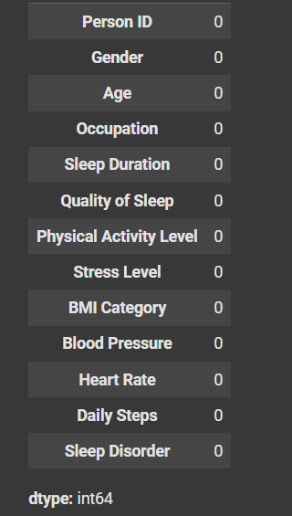
EXPLORATION:
THERE IS NO MISSING VALUES.

Slide 11
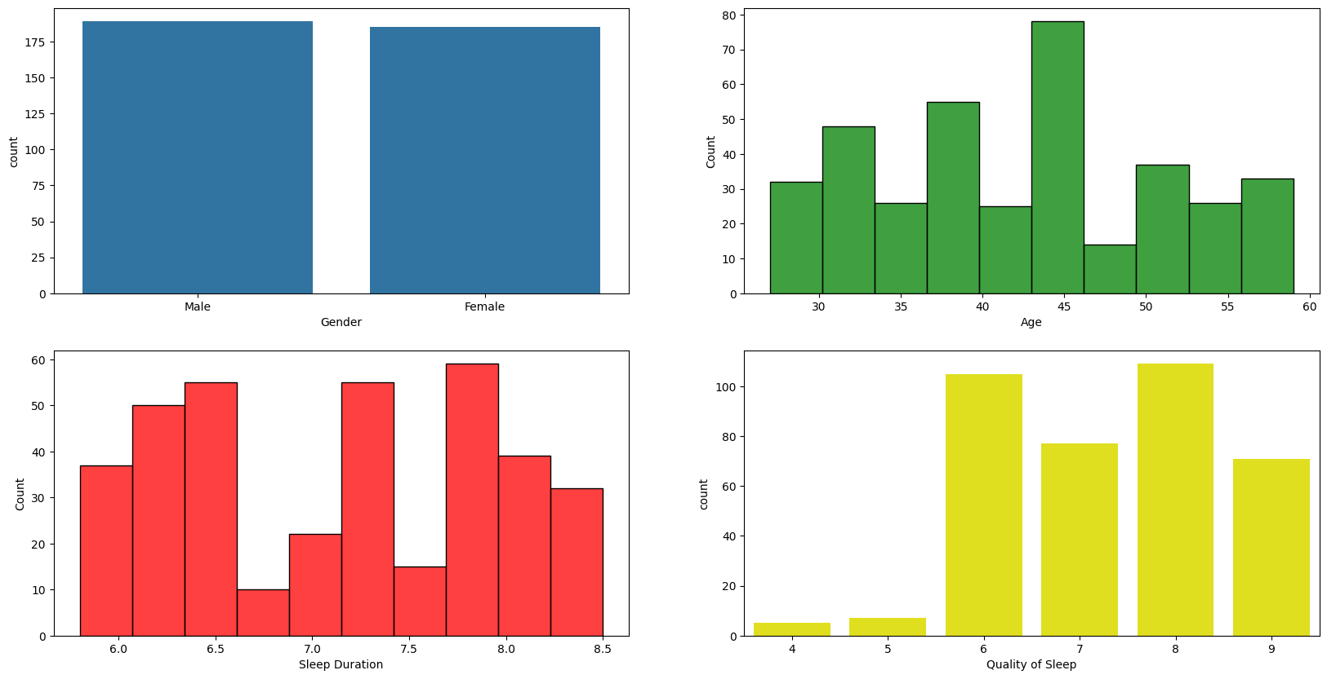
DATA VISUALIZATIONS BASED ON AGE, GENDER, DURATION AND QUALITY OF SLEEP :

Slide 12
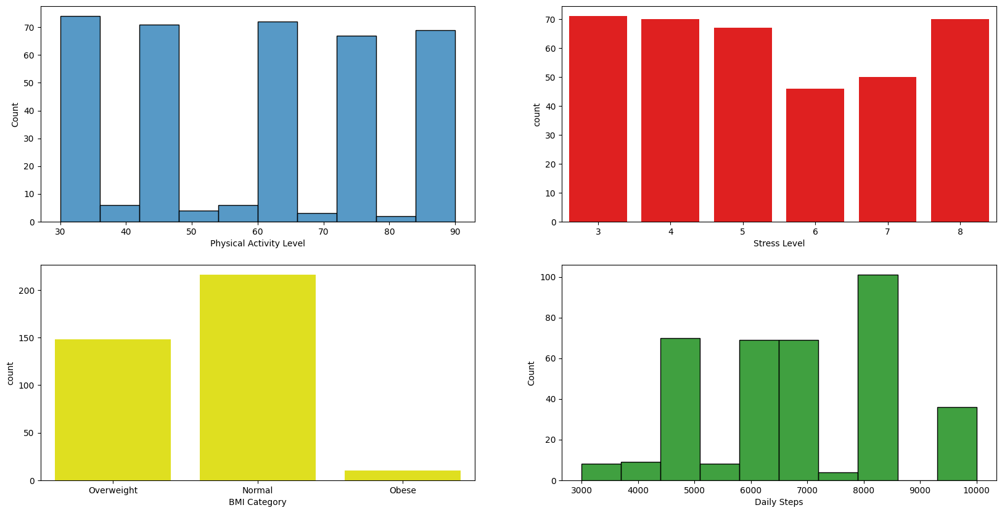
DATA VISUALIZATIONS BASED ON PHYSICAL ACTIVITY, STRESS, BMI, DAILY STEPS LEVEL:

Slide 13
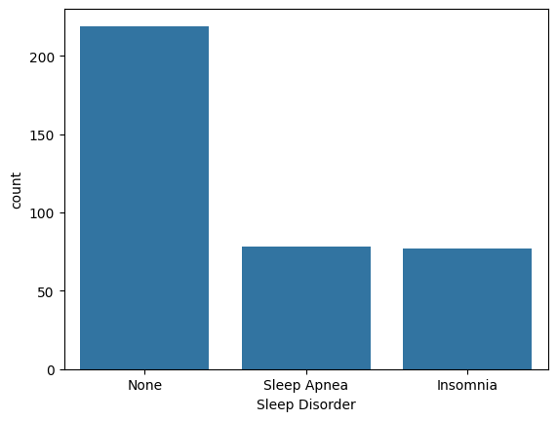
DATA VISUALIZATIONS BASED ON SLEEP DISORDER’S:

Slide 14
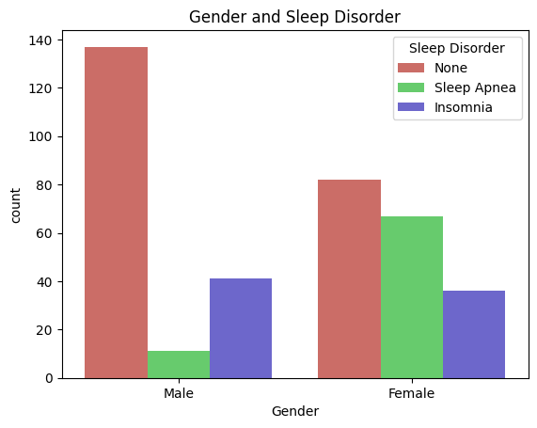
GENDER COUNT PLOT OF SLEEP DISORDER :

Slide 15
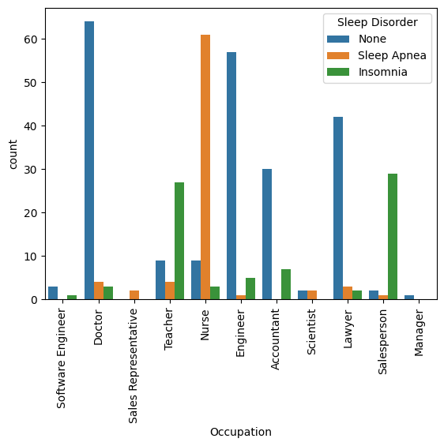
EFFECT OF OCCUPATION ON SLEEP DISORDER :

Slide 16
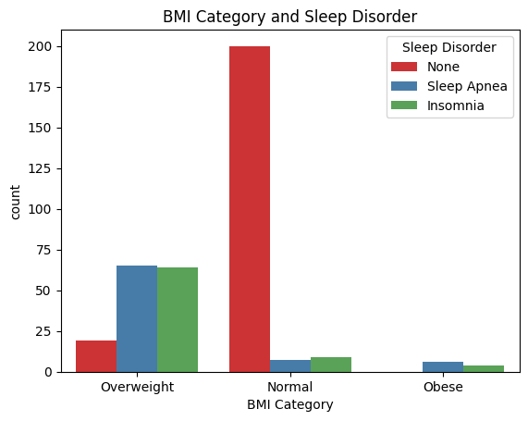
BMI AND SLEEP DISORDER :

Slide 17
CONCLUSION
FROM THE EXPLORATORY DATA ANALYSIS, I HAVE CONCLUDED THAT THE SLEEP ORDERS DEPENDS UPON THREE MAIN FACTORS THAT ARE GENDER, OCCUPATION AND BMI OF THE PATIENT. THE MALES HAVE MORE INSTANCE OF INSOMIA WHEREAS FEMLAES HAVE MORE INSTANCES OF SLEEP APNEA. IN ADDITION THE THAT PEOPLE WITH OCCUPATION SUCH AS NURSES ARE MORE PRONE TO SLEEP DISORDERS. THE BMI OF THE PATIENT ALSO PLAYS A VITAL ROLE IN THE PREDICTION OF SLEEP DISORDERS. THE PATIENTS WHO ARE EITHER OBESE OR OVERWEIGHT ARE MORE PRONE TO SLEEP DISORDERS.

Slide 18
COLAB LINK
https://colab.research.google.com/drive/1bn5mUuLyxFhlcgYltWhnBedXMshplEWd?authuser=1#scrollTo=fipasktBow6e

